Slide 1


Spotify
Data Governance Framework & Implementation Plan
Designed by
Arthur Mbomo : Data governance analyst

Slide 2
Summary 1- Current state overvieuw Data governance Maturity analysis Major challenges of Data Governance at Spotify 2-Data governance framework Organisational chart Data criticity Data governance Keys aspects 3- Implementation pilot plan 4- Expected outcomes 5- Next steps

Slide 3
1. Current State Overview
Maturity Level: Globally Proactive (Gartner Scale: 3)
Strengths:
Robust regulatory compliance (GDPR, CCPA) and data quality practices.
Advanced data infrastructure (data lakes, databases, cloud) and rapid ingestion and data processing.
Business & Data operations teams highly specialized and autonomous
Existing collaboration between DPO, CDO, and cross-functional teams.
Weaknesses:
Fragmented data and siloed systems.
Inconsistent security controls and lack of centralized governance.
Limited automation and AI bias management.

Slide 4
Major challenges of Data Governance at Spotify
1. Current State Overview
2. Data Quality & Compliance
Data quality difficult to maintain with non-integrated data management systems and siloed data and different department needs
3. Communication & internal collaboration
Difficulty in sharing a single data management vision and a common repository between business, IT and data teams ( optimal organizational chart )
4. Sensibilisation & compliance
Complex addressing to all international legal frameworks (GDPR, CCPA, PDPA)
Raising awareness of ethical issues among all employees (AI, users, data usage, etc.)
5. Change Management
Practices by extensive and international teams
6. Security and scalability
Adapting devices to Spotify's rapid growth Implementation of audits, regular checks, and automated alerting
1. Market context
Rapid technological evolution due to increasing demand for user needs and marked competition Multiplicity of sources and massive volume of data (catalogue, listening, playlists, interactions, etc.)
Users are still awake
High technology to hand-on Measuring ROI and governance performance Reduced resistance to change

Slide 5
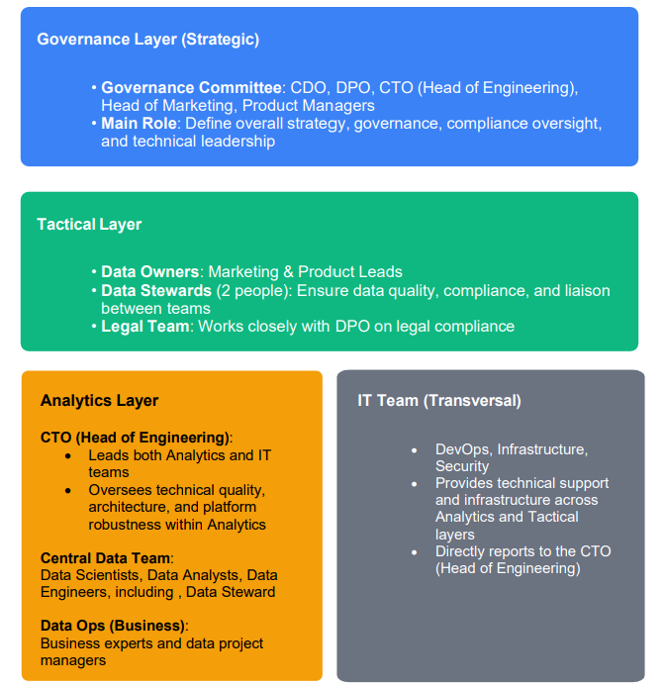
Three-Tier Governance Structure:
2. Data Governance Framework

Slide 6




Spotify Data Governance Policy
Data is classified into three sensitivity levels, each with specific protection measures:
Red Level (Sensitive Data)
Orange Level (Operational Data)
Green Level (Public Data)
User identification data protected with AES-256 encryption, pseudonymization, and strict least-privilege access
Music preferences and interaction logs managed with anonymization, role-based access control, and Collibra catalog tagging
Artist metadata and catalogs with rigorous quality checks and open internal access

Slide 7






Security, Compliance and Data Management
Spotify implements robust security measures and compliance protocols while fostering a strong data culture. The infrastructure leverages multiple specialized tools to ensure data integrity throughout its lifecycle.
Data Culture
Modular literacy programs, workshops, and ambassadors
Security & Compliance
Zero Trust Architecture okta, RBAC, 2FA, ISO 27001, Splunk,Firewall
Tools & Infrastructure
Databricks, Collibra, AWS, Informatica, API Spotify
Security is maintained through Zero Trust Architecture with Okta, role-based access control via Splunk, mandatory 2FA, and AES-256 encryption for sensitive data. Regulatory compliance is ensured through VeraSafe and TrustArc, with strict adherence to user rights and 72-hour breach notification.
Data quality is measured through Informatica dashboards with KPIs for completeness, accuracy, consistency, and integrity. The architecture integrates AWS Redshift for master data, Microsoft SQL Server for operational relational databases, and AWS S3 for unstructured data, all connected through APIs to eliminate silos.

Slide 8
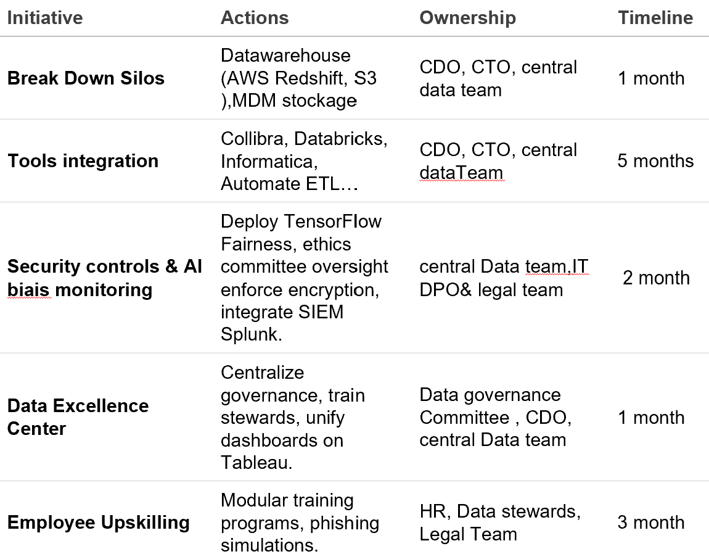
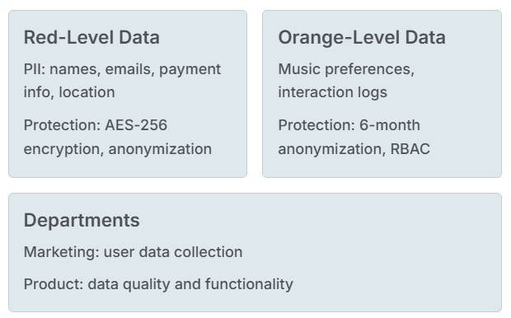
3. Implementation Plan

Slide 9
4. Expected Outcomes
By 2025:
Security: 0 major incidents/year.
Quality: <0.5% data errors.
Compliance: GDPR response ≤10 days
Data privacy : alert on 72 hours.
Long-Term:
Unified data ecosystem.
Trusted AI-driven recommendations.
Global regulatory alignment.

Slide 10
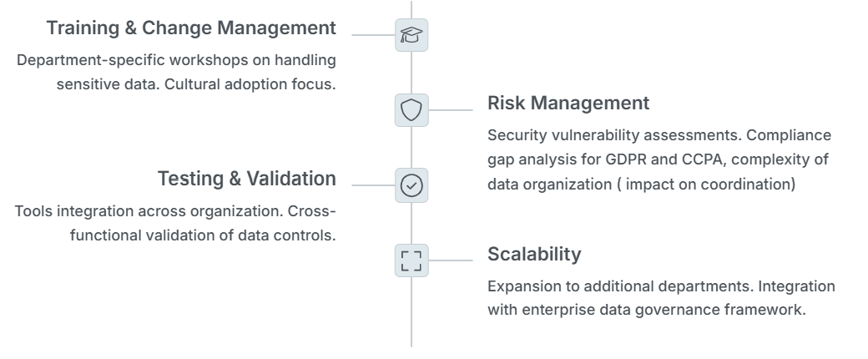
4. Next Steps

Slide 11

Thanks!
See you in the next course

